Slide 1


Kaggle 101 – Getting Started
Recitation Zero – 11-785 Intro to Deep Learning | Carnegie Mellon University
by: Prof Bhiksha Raj
Presented by: Elvis Tanghang & Kipngeno koech, Graduate Teaching Assistant
Deep learning models need two key things: data and compute power. Kaggle provides both - like a brain that helps you not just think, but learn [1].
[1] kip et. al

Slide 2
How You’ll Use Kaggle in This Course
Run and Submit Assignments (Majorly Homework p2s)
We give you starter notebooks
You may import them to kaggle and complete them and run ablations
Submit your results to competitions for leaderboard rankings
Use Competition Provided Datasets
Join competition and access dataset (recommended)
Download the dataset from provided link and upload it to kaggle (re-inventing the wheel)
Access GPU Remotely
No local setup needed
Ensure you have verified your account using a phone number
Projects
If you are looking for GPUs to use for your projects, kaggle can be one of your one stop shops
Collaborate (For Projects)
You can share your project notebooks for your project mates to run ablations

Slide 3
Using GPUs on Kaggle
CPU ( NONE)
GPU (Tesla T4)
GPU (NVIDIA Tesla P100)
TPU (v3-8 cores)
unlimited
30 hours per week
20 hours/week
20 hours/week
Default runtime option, ideal for EDA, small models, preprocessing
Ideal for deep learning model training
More powerful than the T4, better for training large models or when faster convergence is needed.
Optimized for TensorFlow workloads
Max 12 hours per run
Max 9 hours per run
Enable via Settings
Navigate to Notebook → Accelerator → choose Accelerator type
To check accelerator type: create a code cell & run: !nvidia smi
Tip:
You can monitor your weekly quota by going to your profile → Account Settings → Compute Usage
Don’t waste GPU/TPU time on preprocessing or EDA — do that with CPU, and enable GPU only for training or inference.
If you exceed your limit, you’ll need to wait until the next quota reset (weekly). There’s no way to pay for more time on Kaggle!!!.
Ensure you have verified your account using a phone number, otherwise you cannot access the gpus!!!

Slide 4
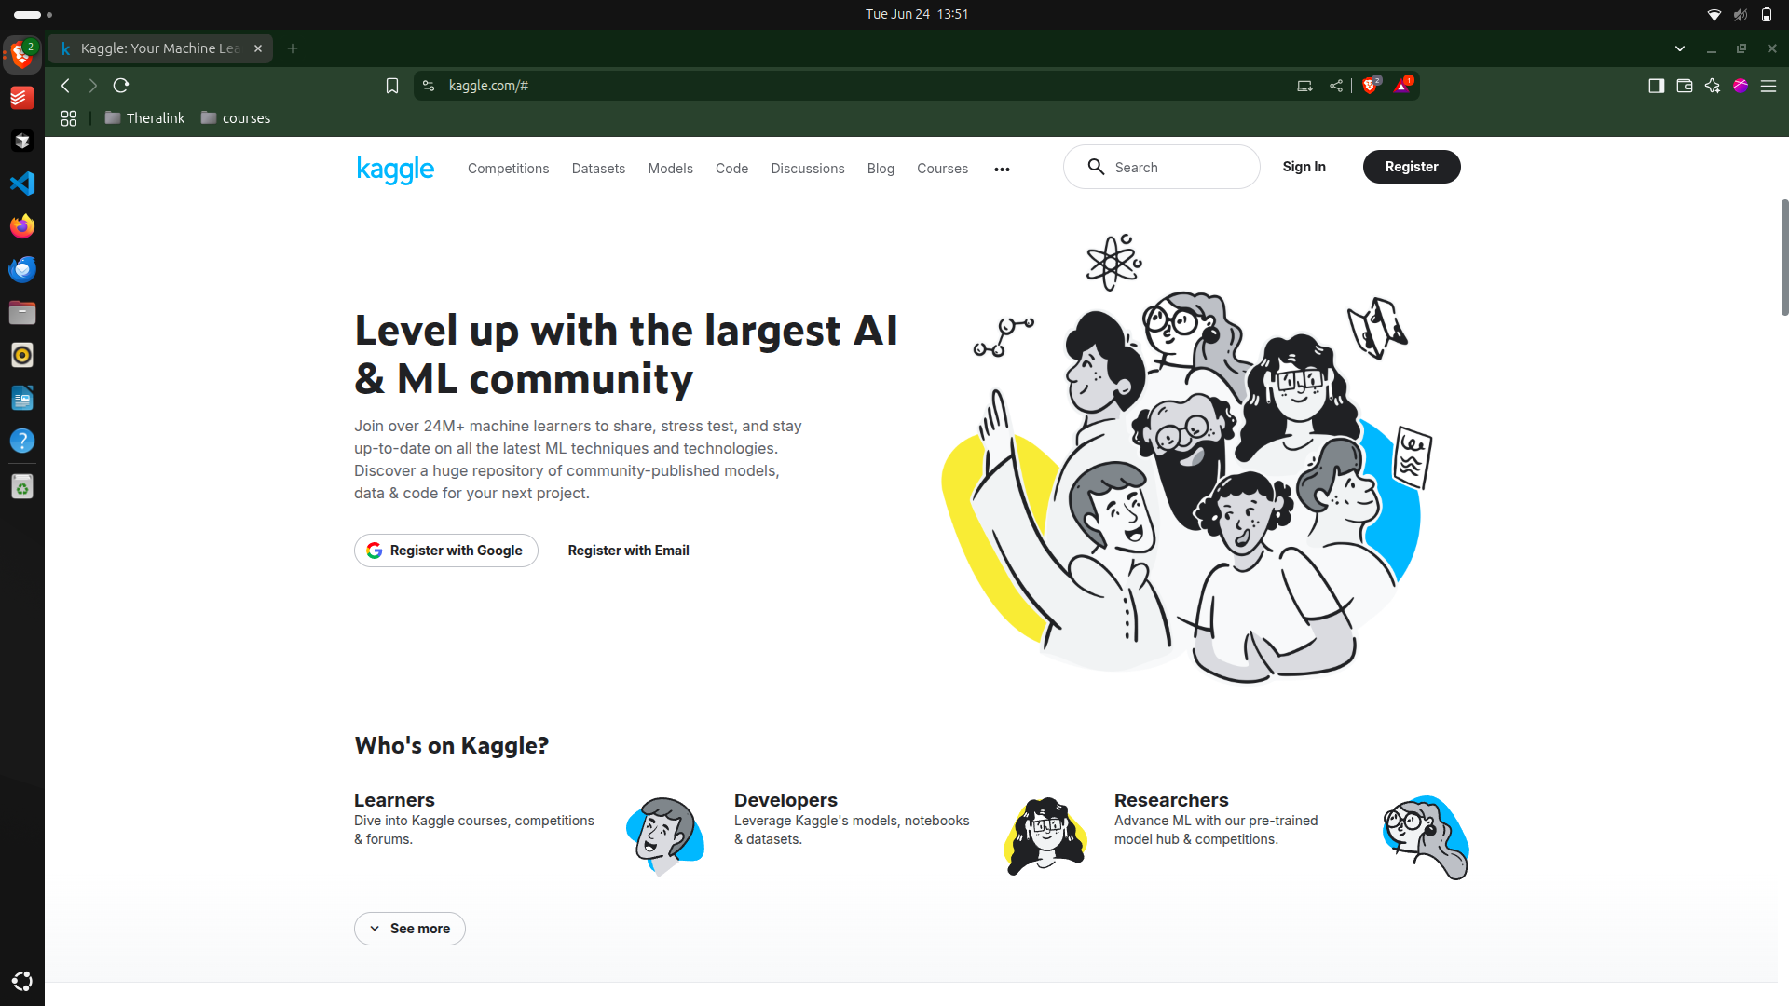

Slide 5
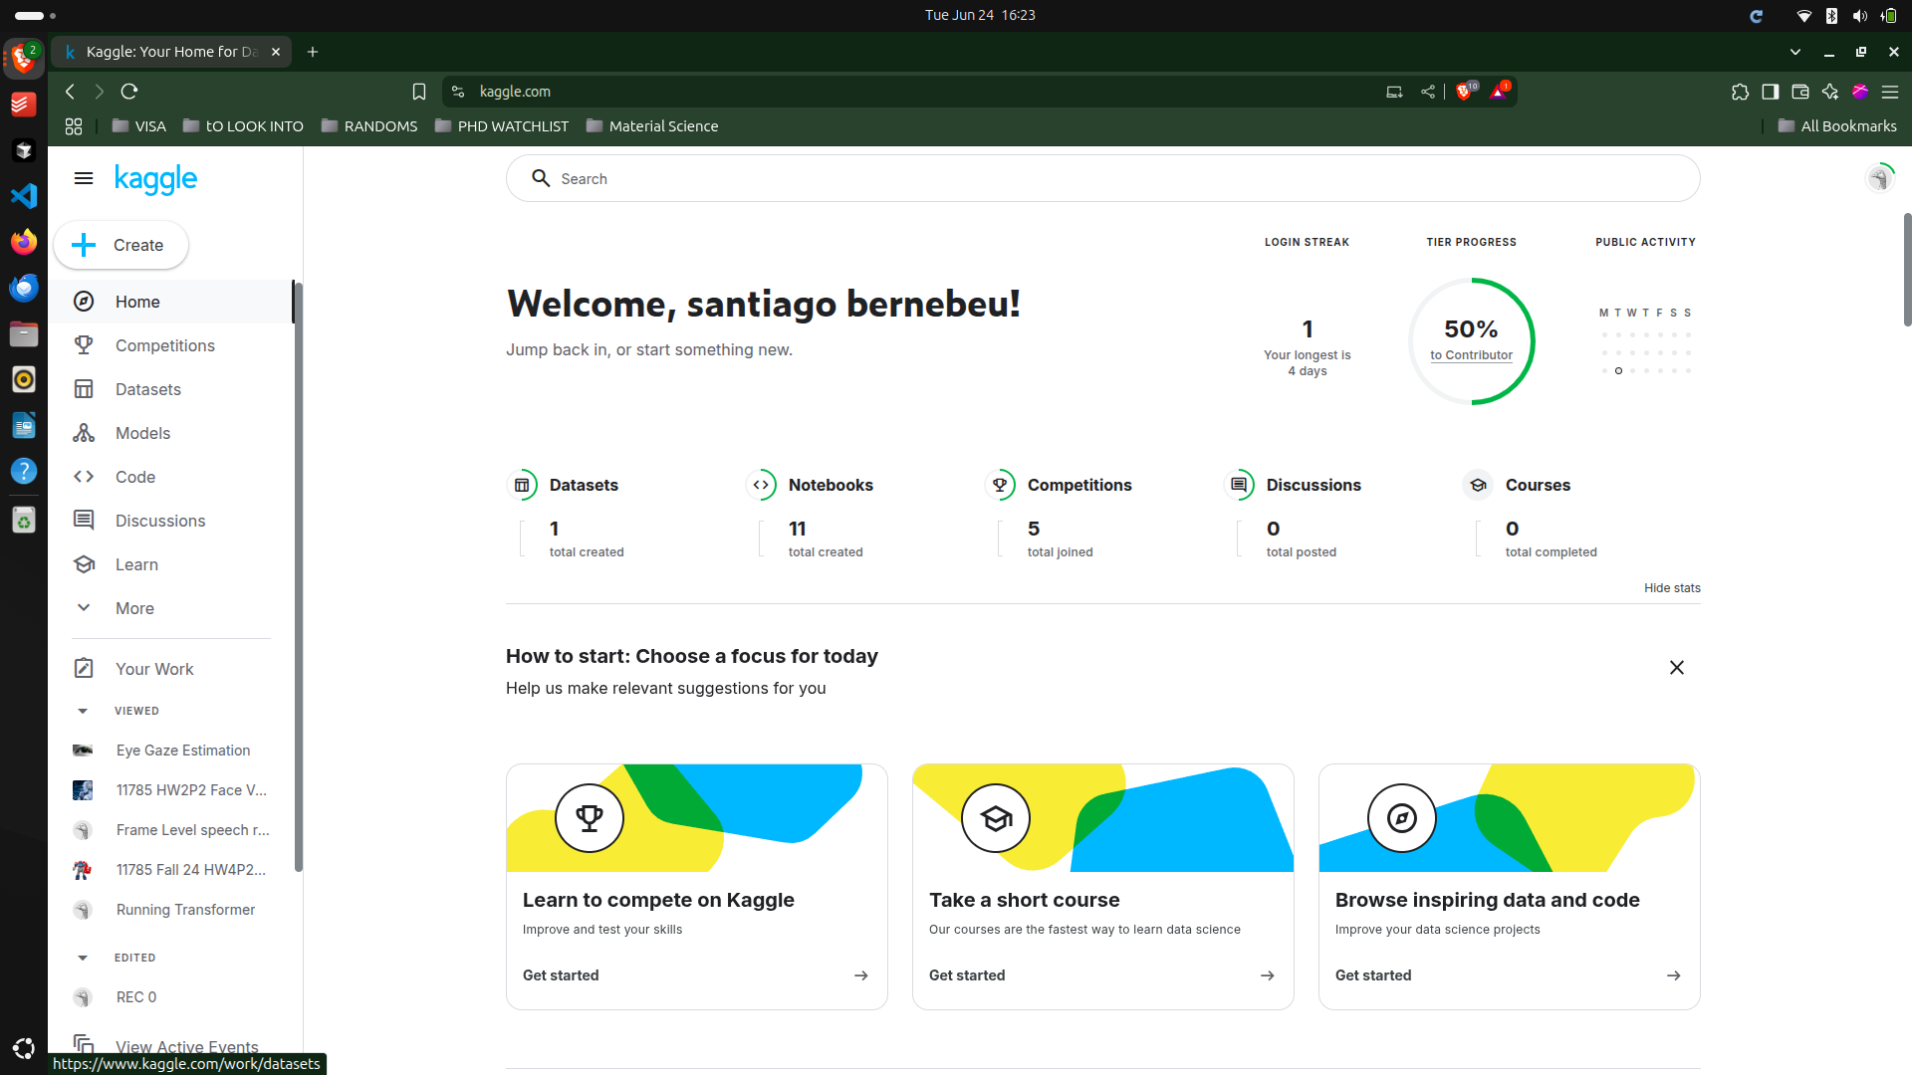

Slide 6
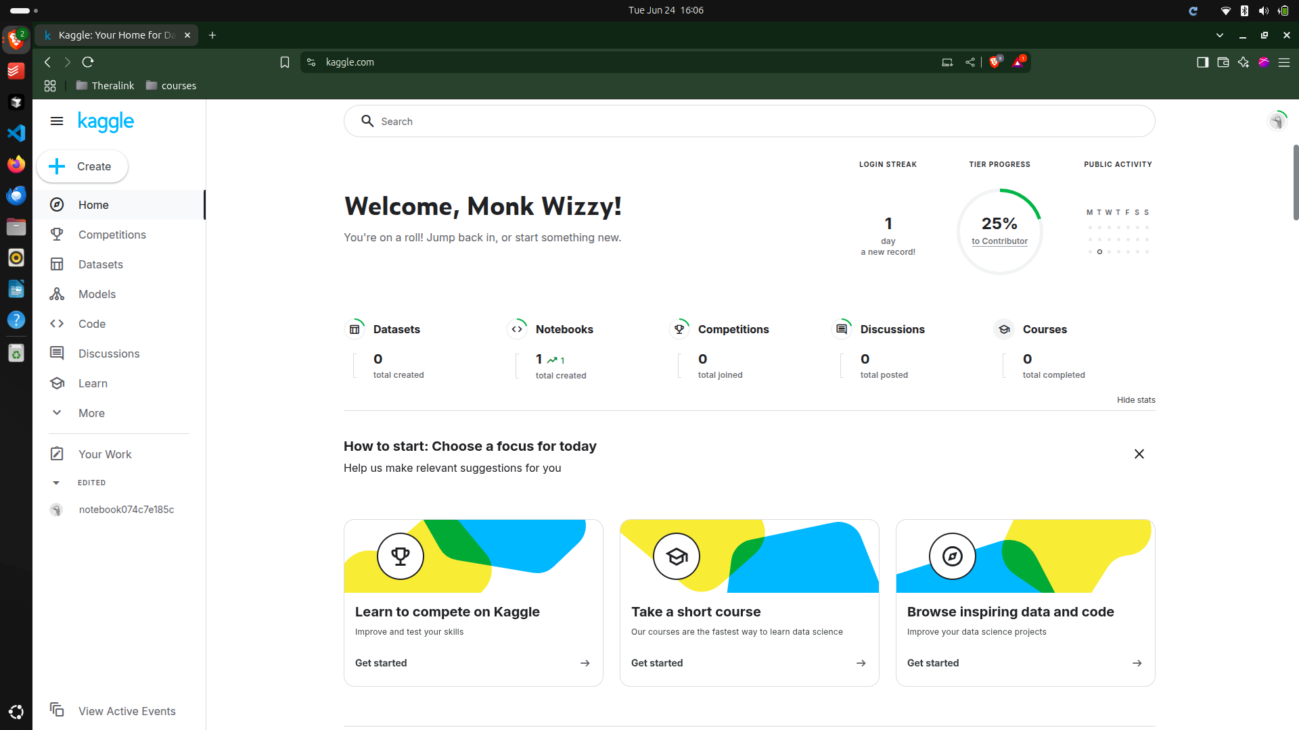

Slide 7
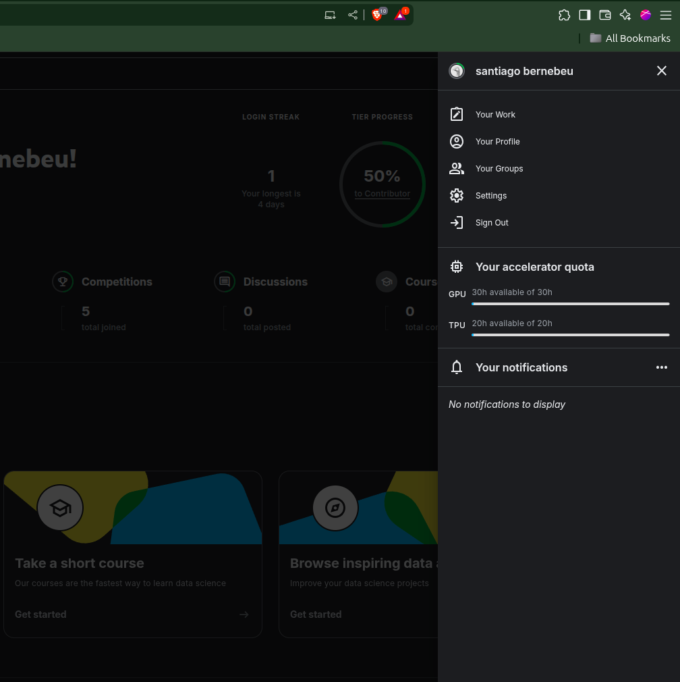
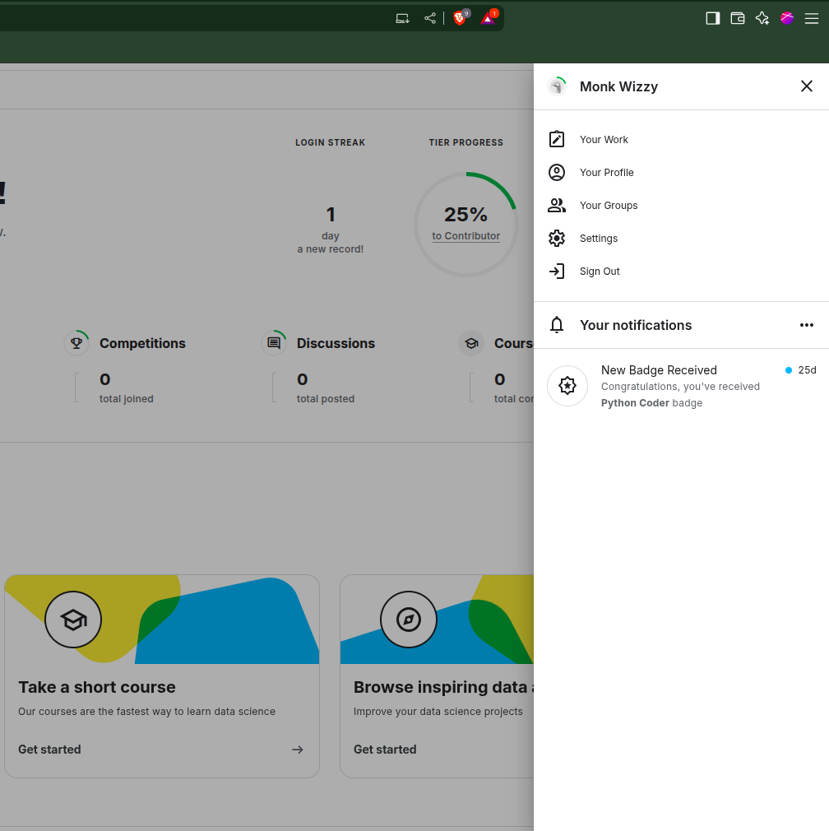

Slide 8
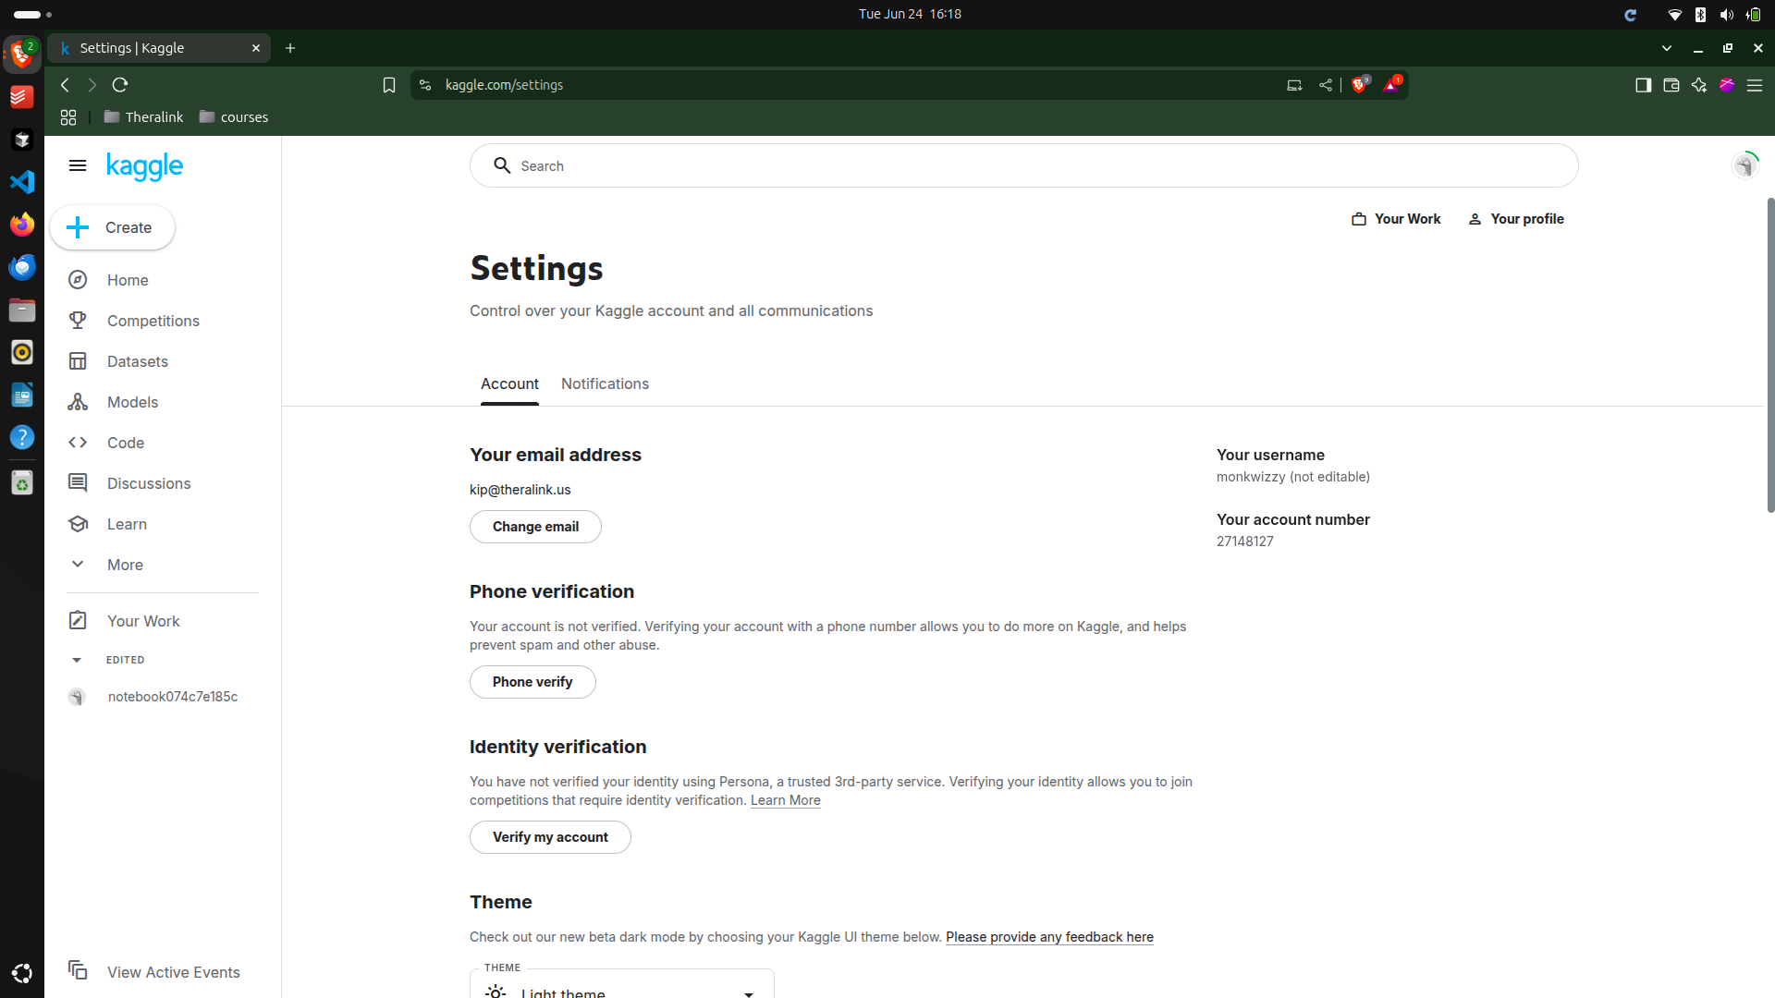

Slide 9
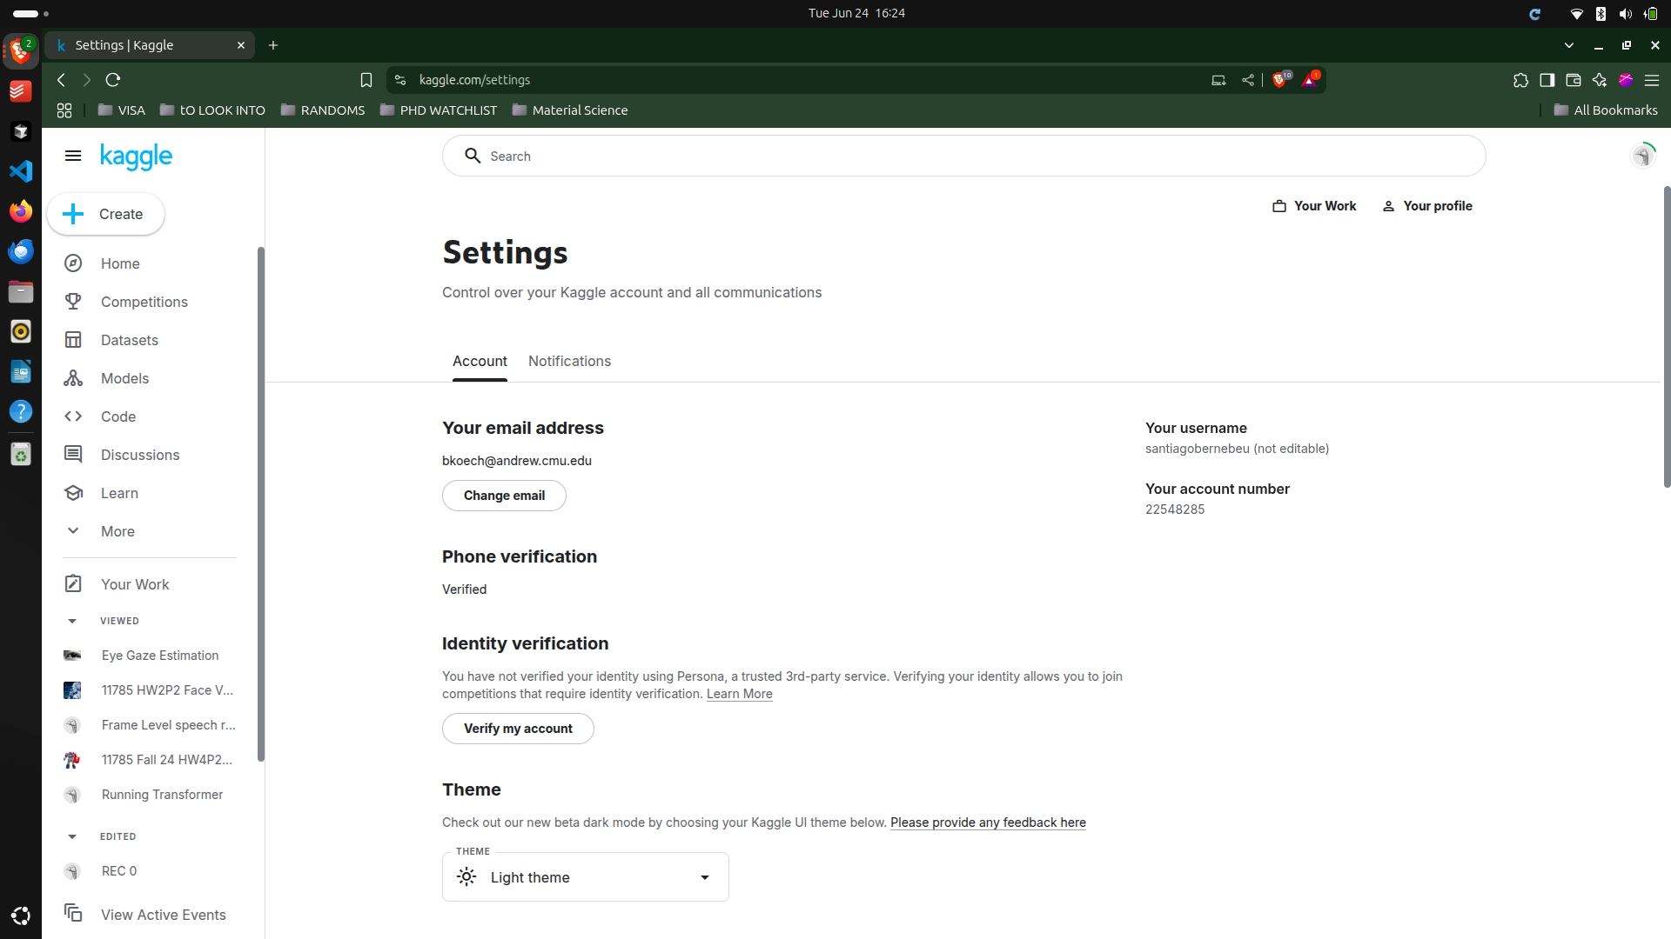

Slide 10
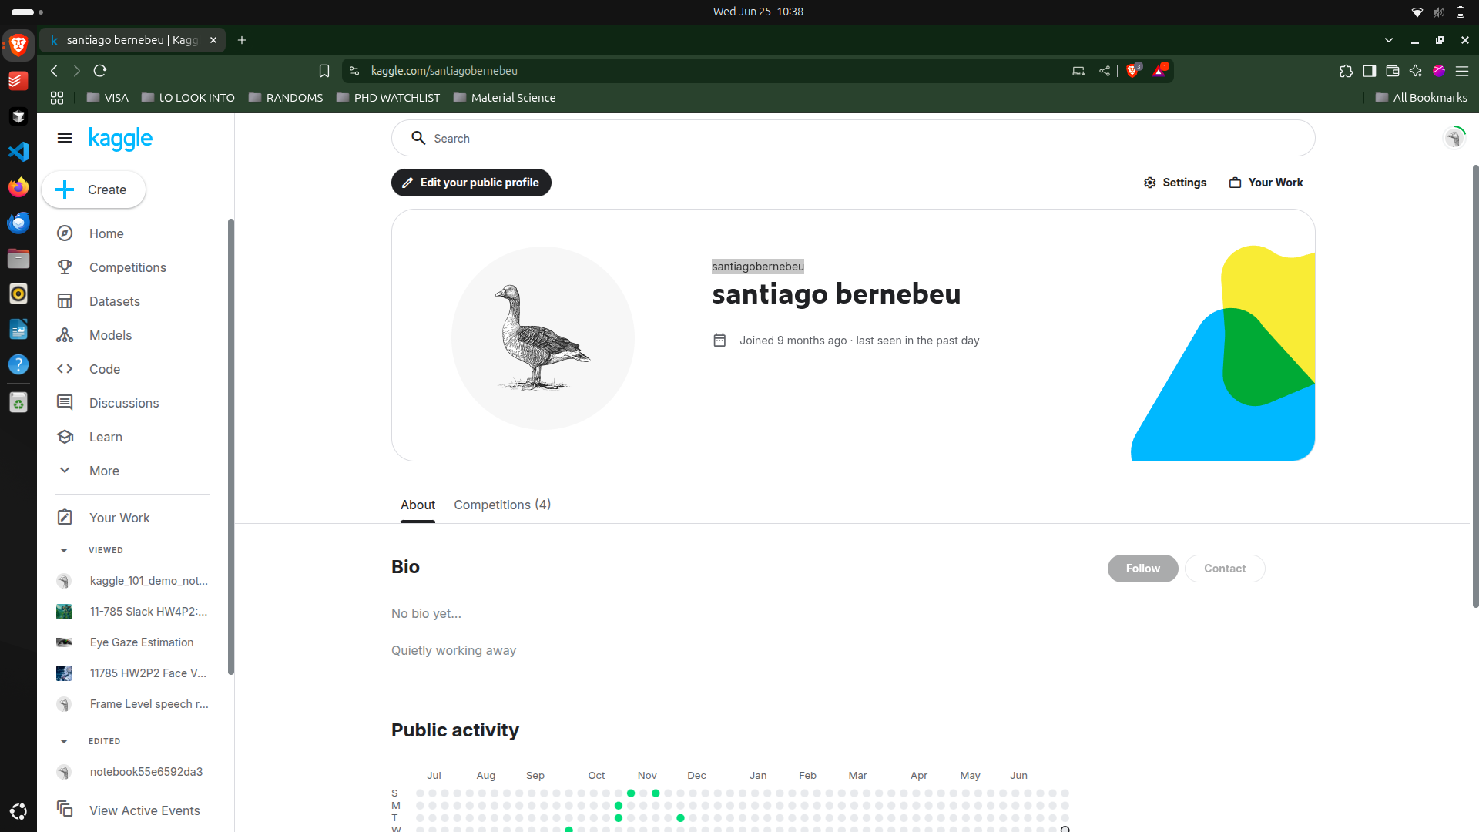

Slide 11
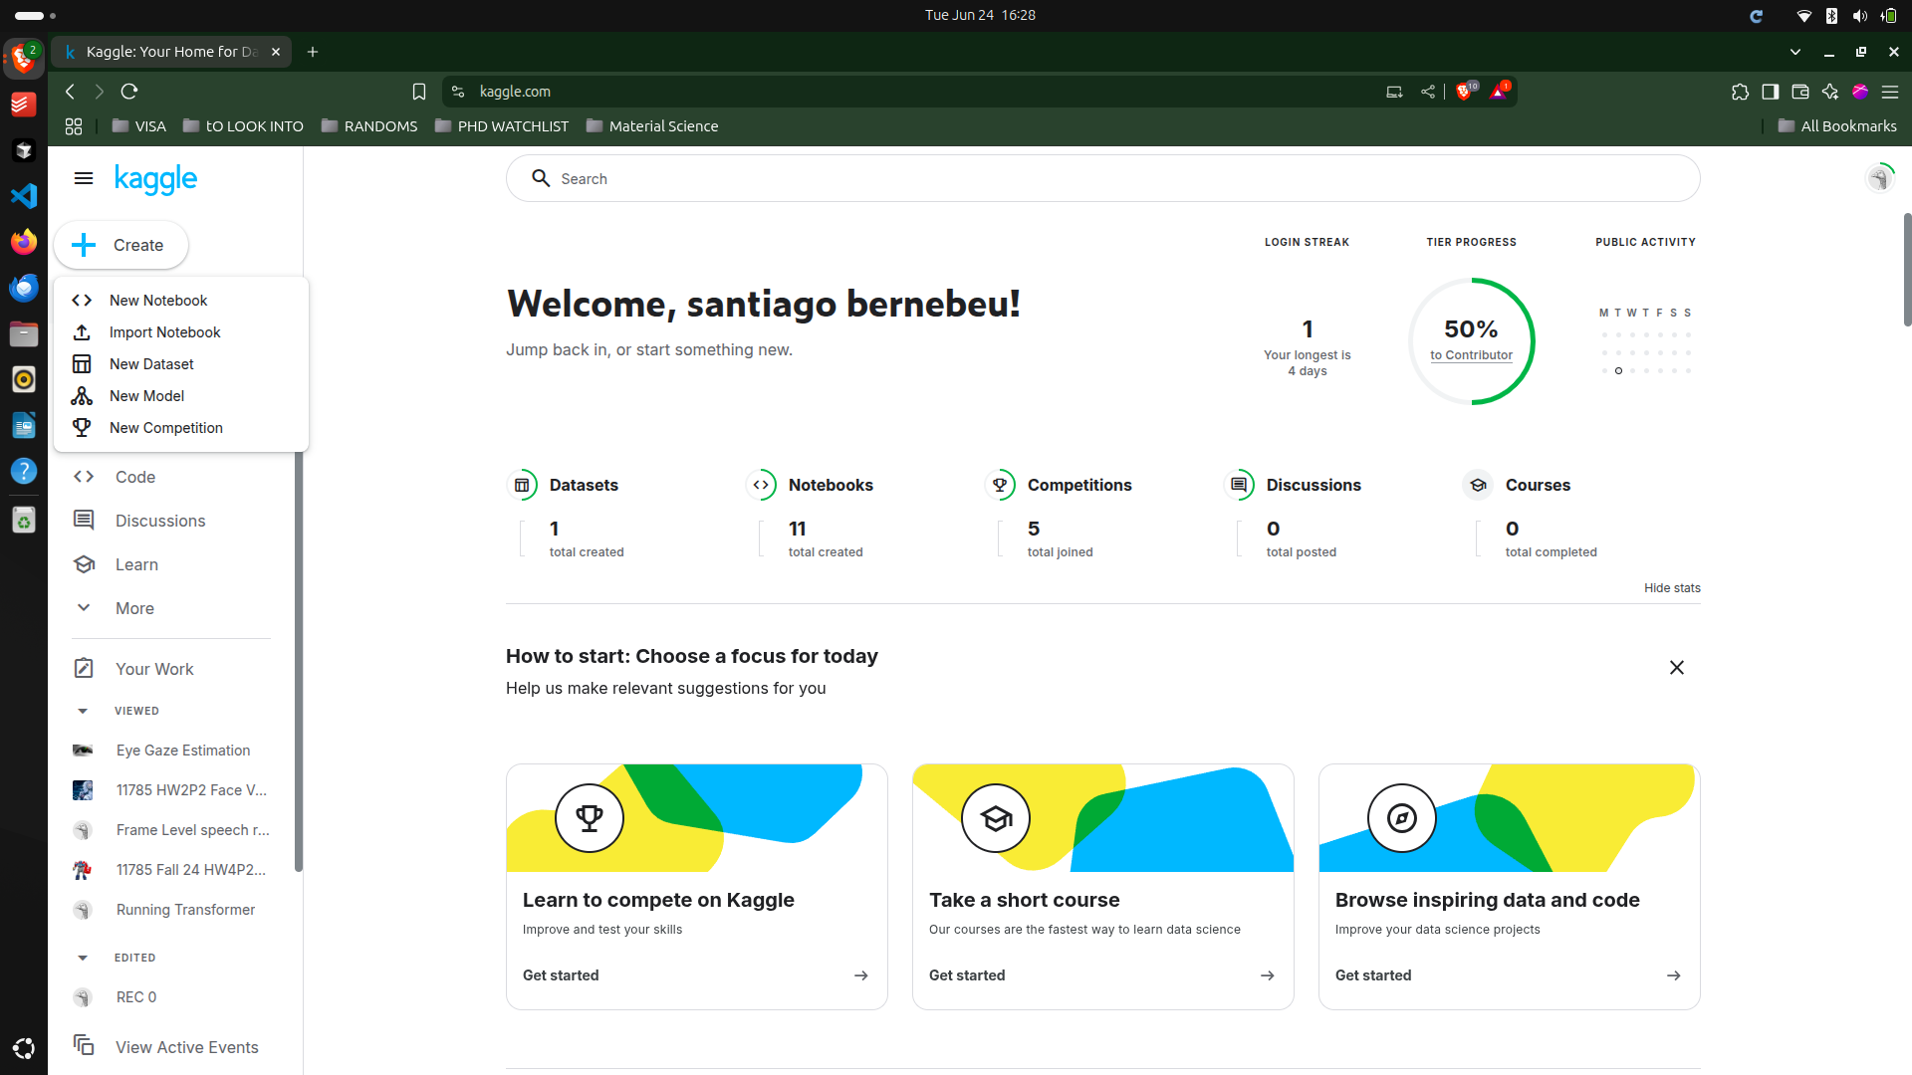

Slide 12
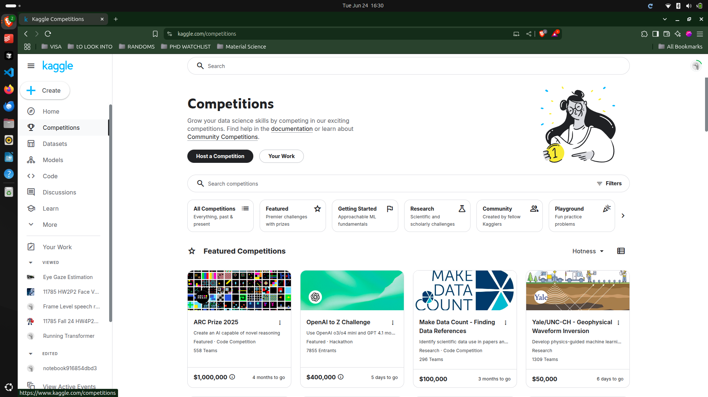

Slide 13
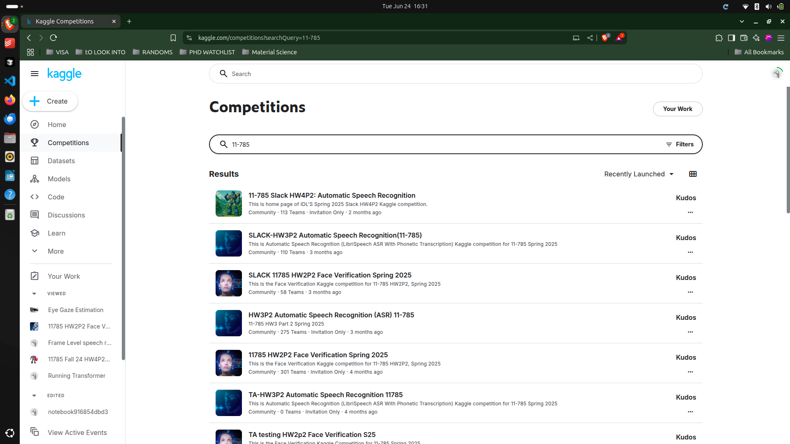

Slide 14
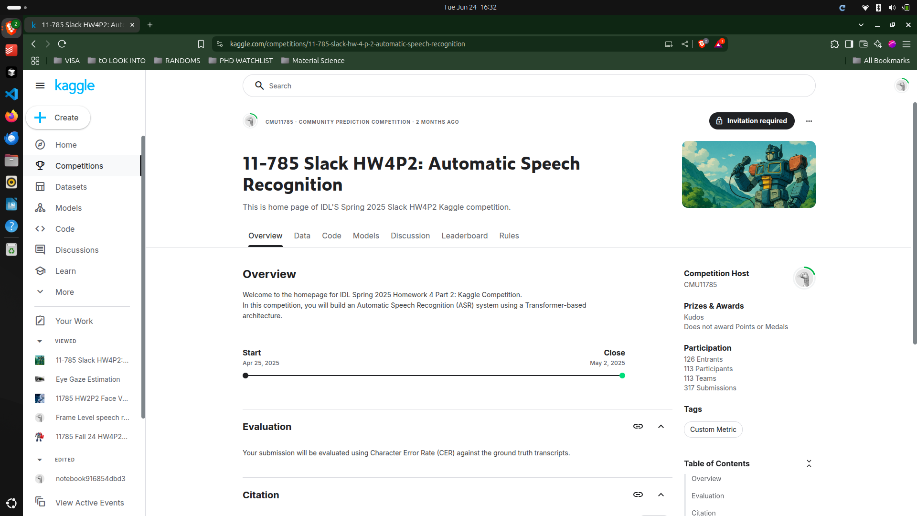

Slide 15
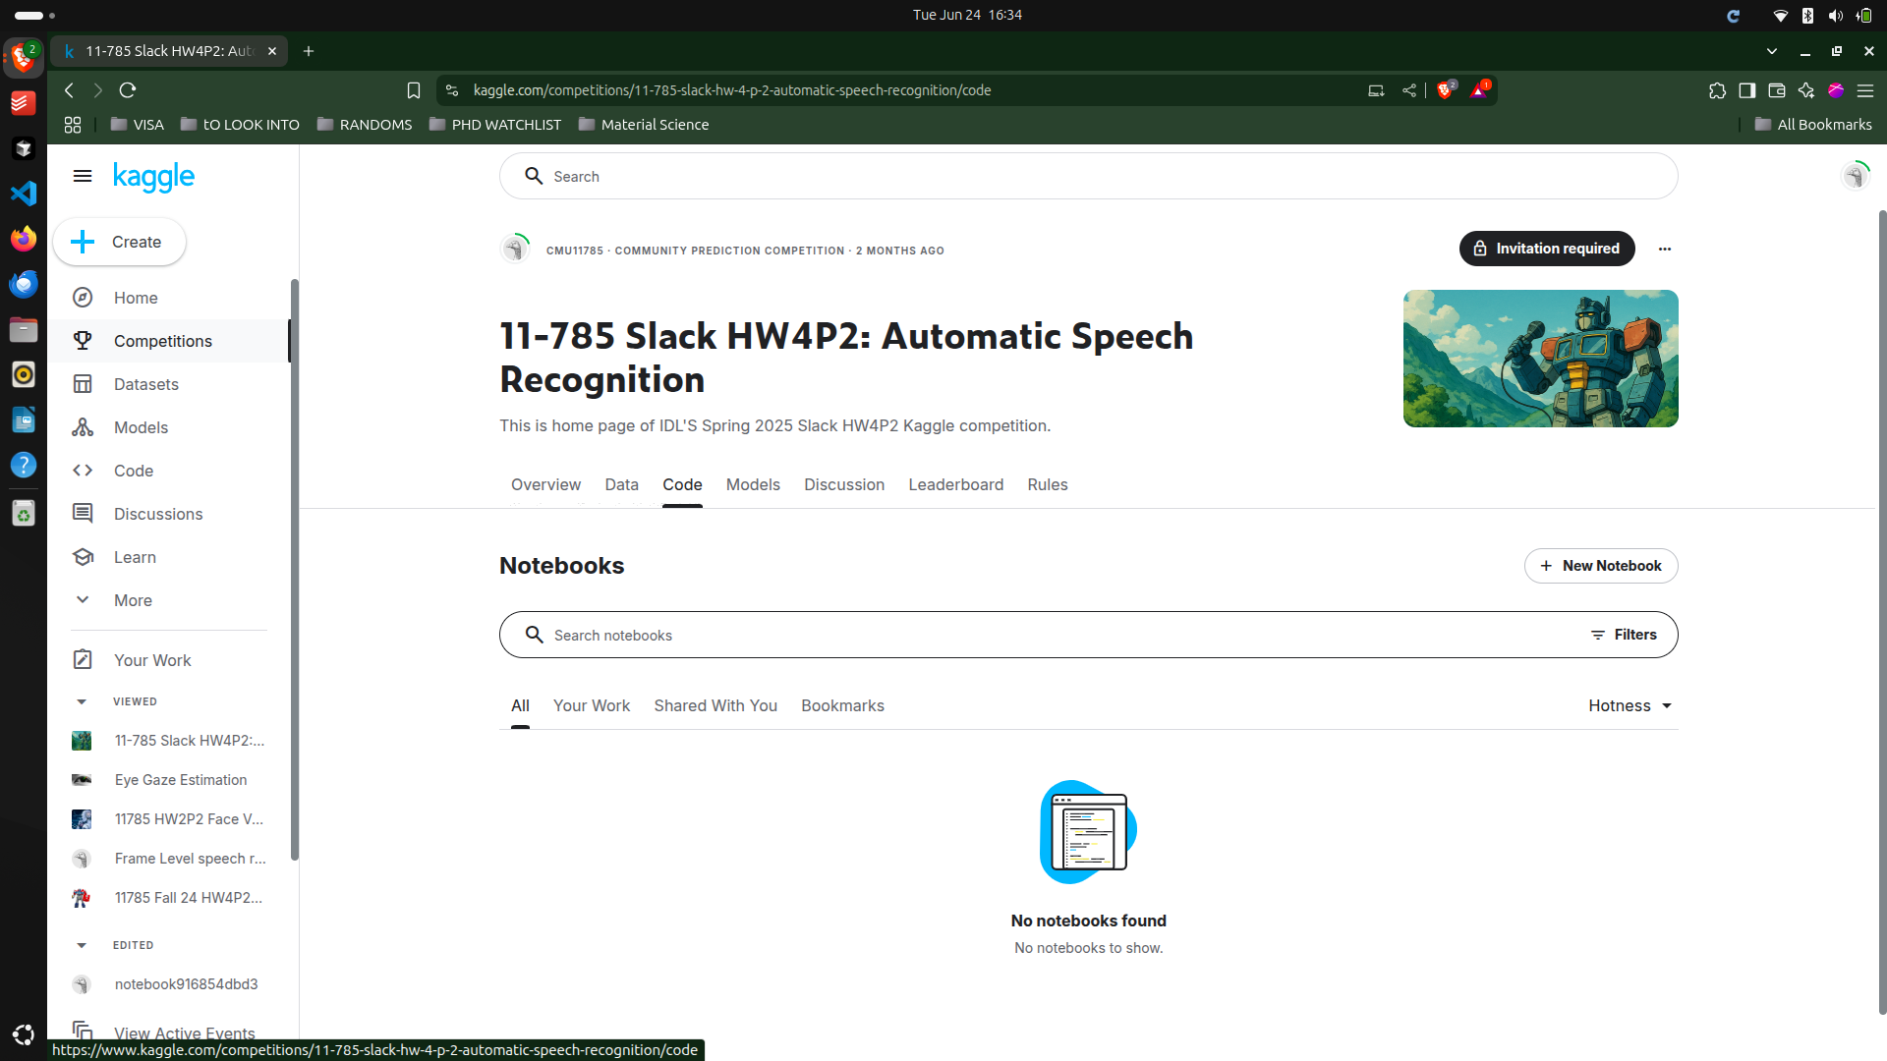

Slide 16




Tips
Stop active sessions
Train on cloud
When you are not training anymore, ensure active sessions are stopped
Run one epoch, if your notebook runs end to end, increase number of epochs and train on cloud
Create multiple Kaggle accounts?
Save your checkpoints
You can verify(using phone number) as many kaggle accounts as you want, each kaggle account gives you free 30 hours of GPU
Save every best model you get, so that if kaggle crashes, you can always resume from your best model thus far, this will ensure that your previous trainings don't go to waste

Slide 17
QUICK DEMO

